Slide 1
TEAM 02
Lucas Nguyen Thai Vinh (162548Y)
Lim Ziyi Jean (1621514Z)
Shishanth Kaliannan(161953P)
Gabriel D’Cotta (151593S)

Slide 2
INTO THE CARNIVAL

Slide 3
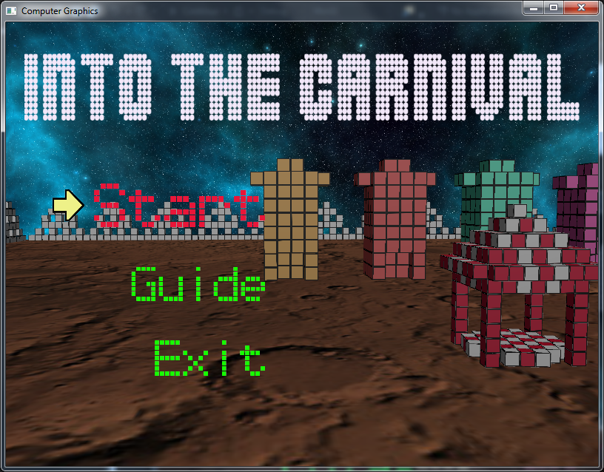
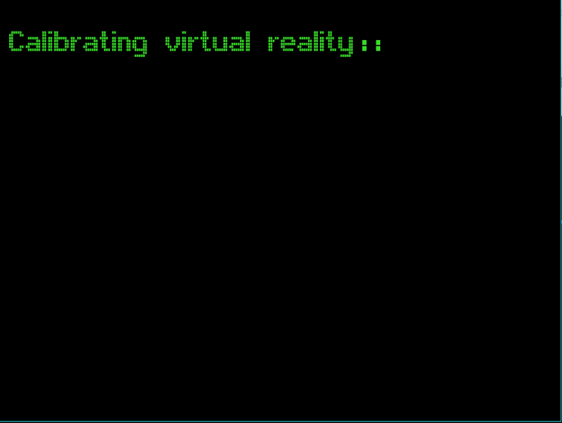
Game idea
Futuristic
Mini-games
Action-based
Exploration
First/third person’s view

Slide 4
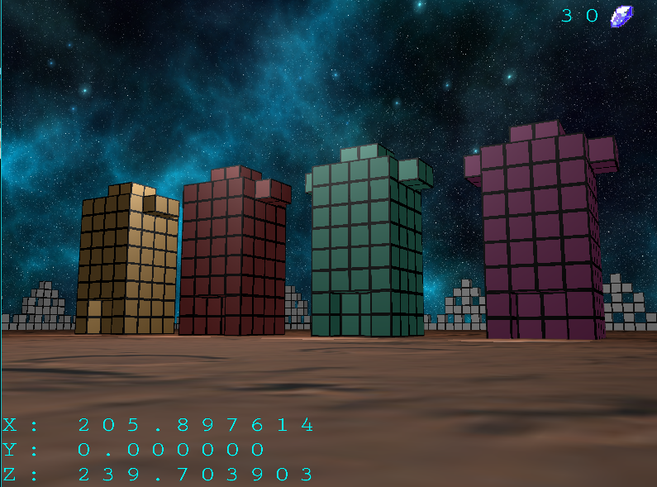
Mini games
Shooting + Treasure hunt
Platform jumping
Driving
Spaceship fighting

Slide 5
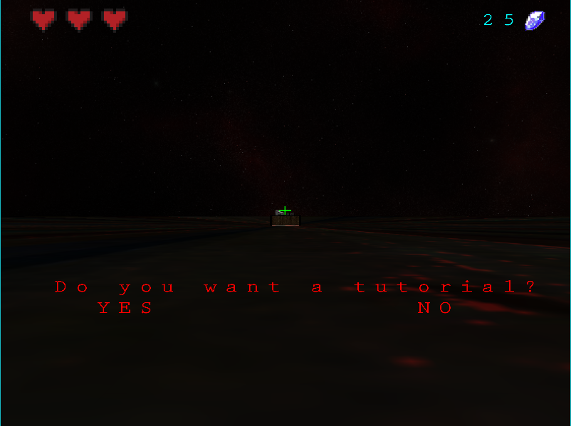
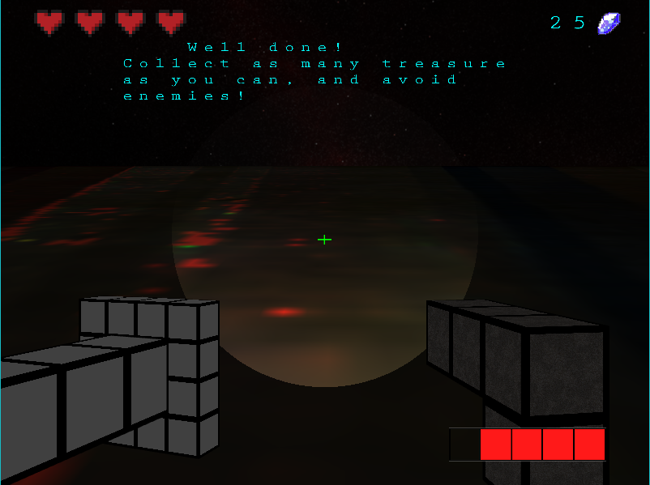
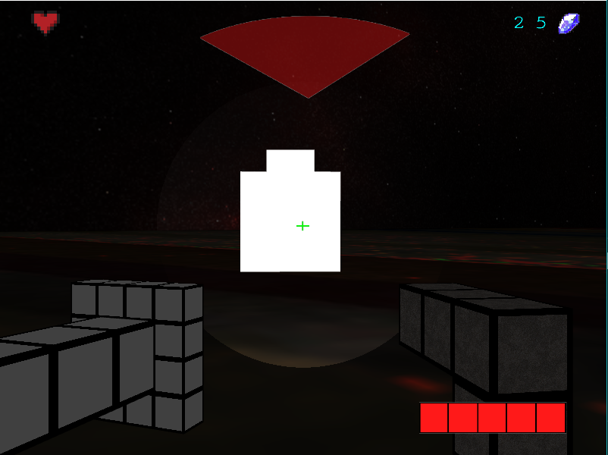
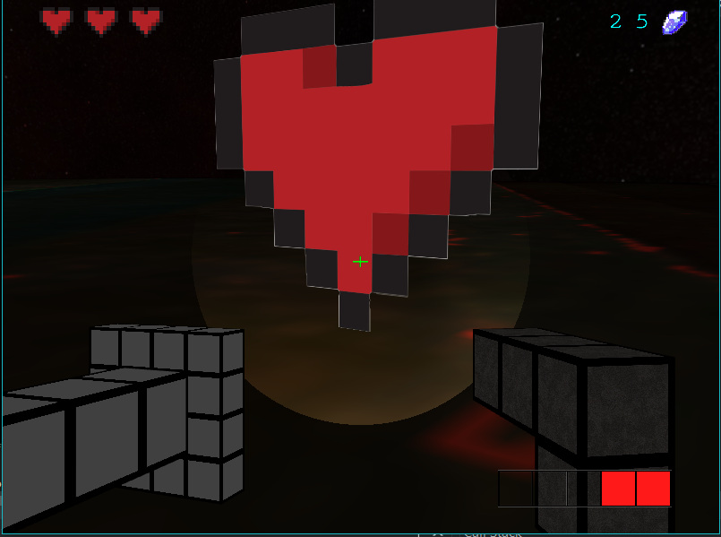
Shooting + Treasure hunt
First-person
Game ends only when player dies

Slide 6
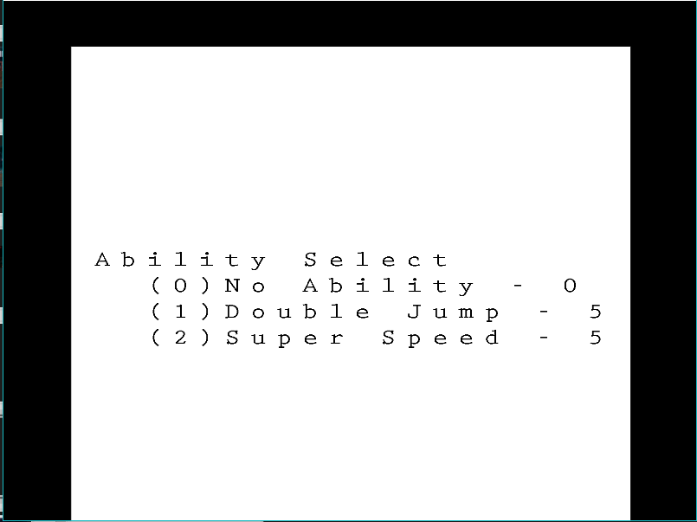
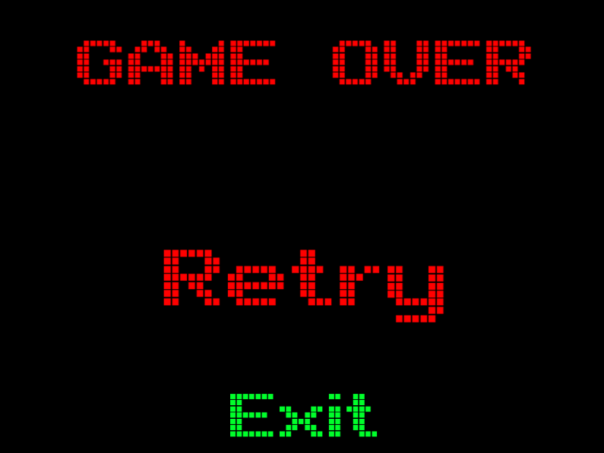
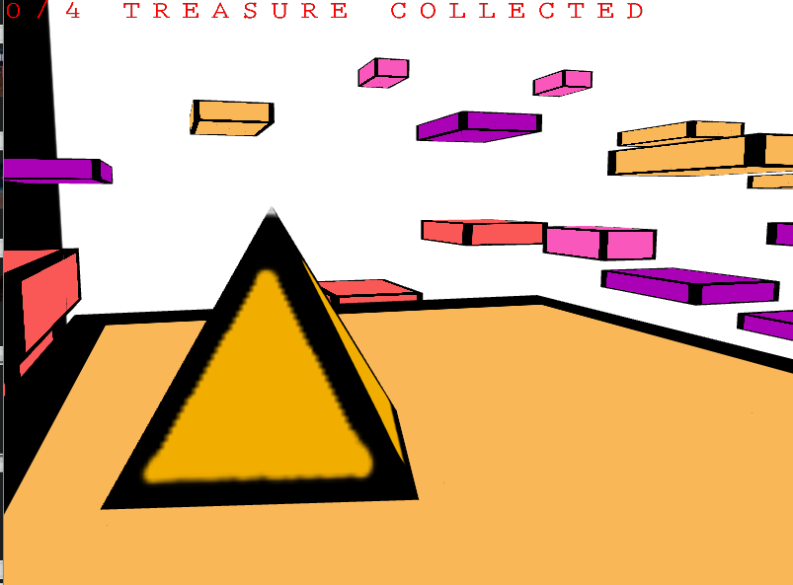
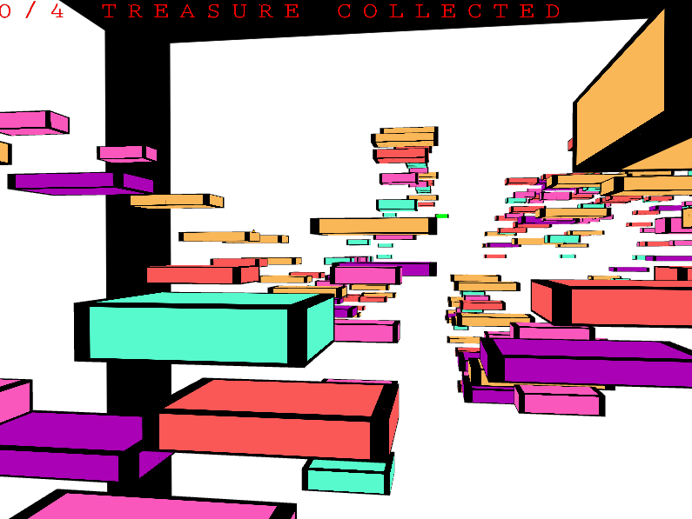
Platform jumping

Slide 7
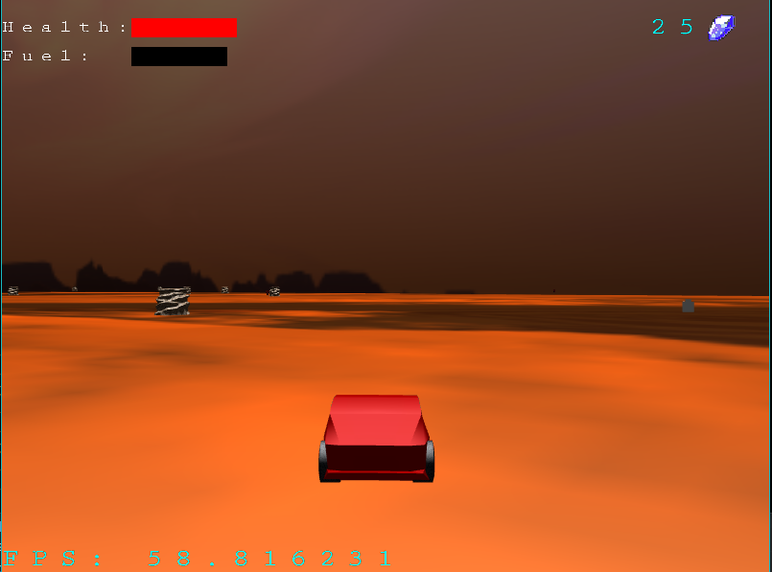
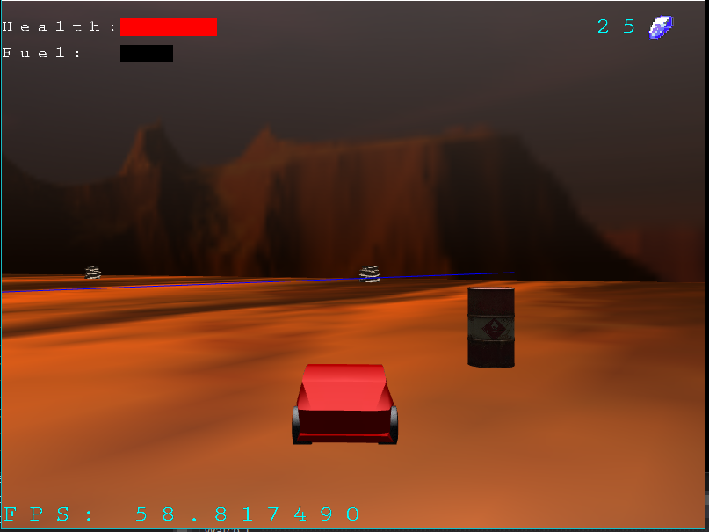
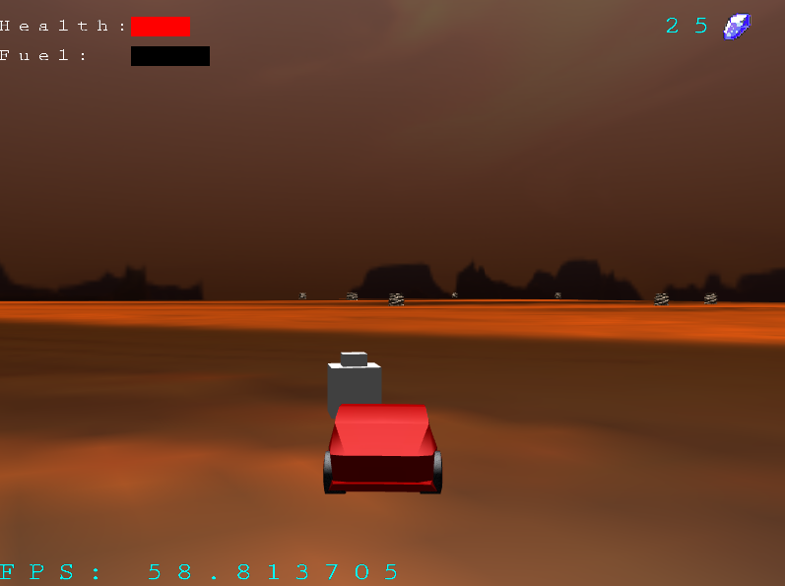
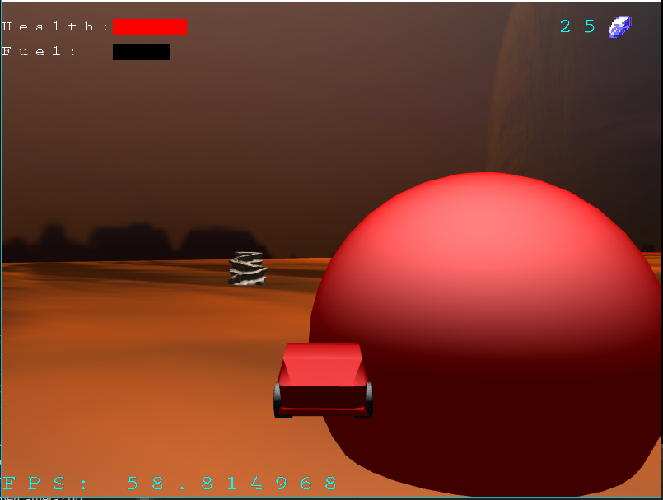
Driving

Slide 8
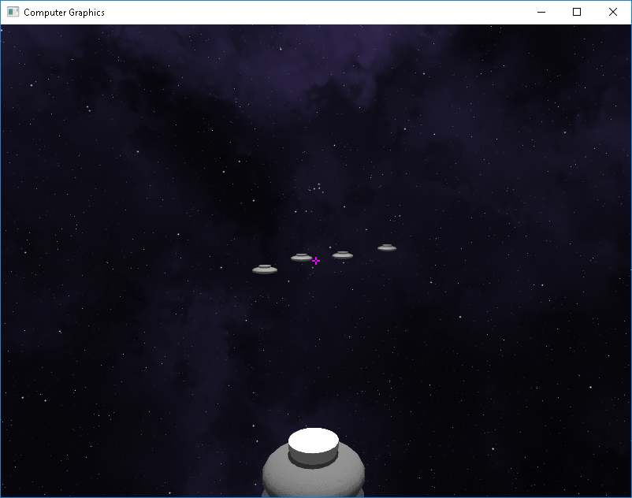
Spaceships
A game on UFOs.
Third person defend game.

Slide 9
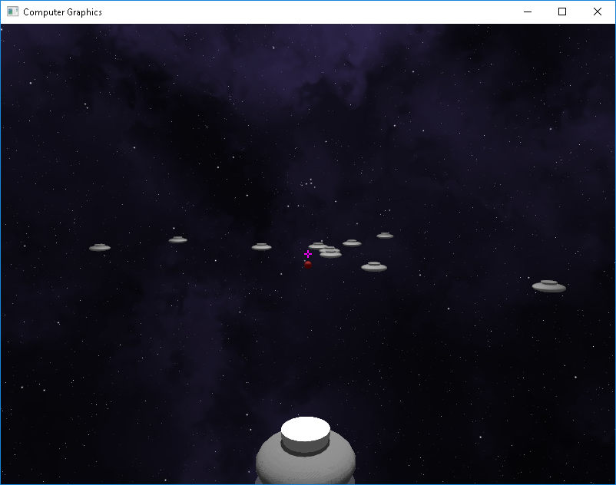
Spaceships
Enemies go in random directions.
If they reach a border (no visual border),
You lose.

